Slide 1

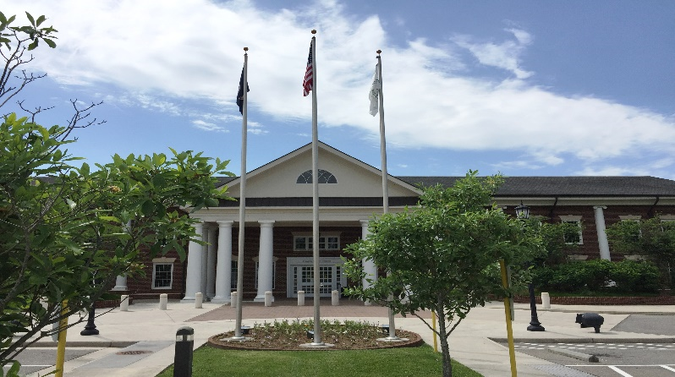
Franklin County
Children’s Services ACT
FY 24 Budget Request
February 7, 2023

Slide 2
Agenda
FY 24 request
Review of last years expenditures
Midyear comparisons
Community needs

Slide 3

FY 24 Requests
Mandated budget of $6,512,206
  Account for increase in service costs
  Inline with FY 23 budget from OCS
  $2,083,906 estimated local match
    Gross cost increase of $368,615
    Net cost increase of $117,957
Non-mandated budget of $140,887
  Net cost $19,936 (no change)
Full-Time Position $79,000 est.
  Includes salary and needed start up supplies
Notes:
Rate changes usually average 5%, won’t have until April-May

Slide 4
Agency Breakdown FY 22
Notes:
CSU 32 children $557,223.50
EDU 87 children $1,952,921.00
CSB 22 children $513,650.00
DSS 110 children $3,569,020.00

Slide 5
Service Expenditure Breakdown FY 22
Notes:
Foster care little control over when a child comes into care or how long they stay. Do have some control over services and placement type
Private Day CSA has no control and must follow Federal Law
$6,592,814.38 (before 3rd party reimbursement, parental co-payments, state match)
Private Day $2,073,803 61 children
Residential $1,559,388 43 children
CB $722,482.8 151 children
Foster Care $2,237,141 89 children

Slide 6
Children Served Per Agency Mid Year

Slide 7
Services by Child
Local Match Rate
35.37% 28.30% 14.15%
Notes:
A child/family can receive services in more than one category

Slide 8
Projected Gross Costs Per Service
Local Match Rate
35.37% 28.30% 14.15%
Notes:
Community based includes, non-mandated – 150 total children
FC res – 7
PP – 5
Res ed – 24
IVE – 16
TFC – 24
PD – 47
FFC – 31
CB - 150

Slide 9
Average Gross Cost Per Child

Slide 10

Projected Costs
Through December gross cost projections are about even with FY 22
Shift in focus of services
  Proactive rather than reactive
  Increase in children getting community-based, preventative services
  Decrease in residential, private day, and therapeutic foster care placements
Notes:
Net costs are down compared to last year, lower local costs
Community based rates are less than residential, private day and TFC

Slide 11
Current Community Needs
Increase in number of children before the courts
  Serious crimes
  Behavioral issues at school and in the community
  Sexualized behaviors and crimes
Truancy
High rate of substance use
  Family drug court has started
Complex mental health needs
Grandparents and other family members as caregivers

Slide 12
Utilization Management/Utilization Review Specialist
Utilization review is required under the code of Virginia
Local policy was created to be inline with OCS best practices
  Will review the necessity, efficiency, effectiveness and appropriateness of services
  Findings will be used to identify trends, progress, and areas of growth
  Family Satisfaction
  Vendor engagement and follow up
Localities of similar budgets/children served have 3 staff members
  Pittsylvania $5,358,123, 156
  Bedford $5,302,008, 195
  Campbell $4,843,737, 155
  Fauquier $3,898,778, 174

Slide 13
Utilization Management/Utilization Review Specialist - Continued
Cannot guarantee cost savings
  Will allow us to closely monitor service use
  2020 audit findings questioned costs of $50,307 that could have been avoided with a UM/UR specialist
  Independent Living savings could have been caught sooner
Current staffing does not allow for full review
  Most cases will need to be reviewed every 90 days
  Each review takes 2-4 hours to complete
Current caseload is not sustainable with staffing levels
  On average 200 open cases
  Each case takes between 30 minutes to 5 hours a month if no issues
  On average most open cases take 1.5 to 2 hours a month to manage
  Non case related duties
Notes:
IL was not providing results, costs about $7,000 a month per child, 1 child that has been getting the service for 2 years. Updated the policy with a cap on service length. This change has the potential to save $190,000 per child over the life of the service 3 years. Could have been caught and changes made sooner if there was someone dedicated to managing and reviewing services

Slide 14
Questions?

